Slide 1

Software Design (swD392)
Ch14 - Real-Time Software Architecture Case Study: Automated Guided Vehicle System

Slide 2
Main Contents
Problem Description
Use Case Modeling
Static Modeling
Dynamic Modeling
Design Modeling

Slide 3
Problem Description
An AGV System has the following characteristics:
A computer-based AGV can move along a track in the factory in a clockwise direction, and start and stop at factory stations.
The AGV system receives Move commands from an external Supervisory System. It sends vehicle Acknowledgements (Acks) to the Supervisory System
indicating that is has started moving, passed a station, or stopped at a station. The AGV system also sends vehicle status to an external Display System every 30 seconds.
It is given that the arrival sensor is an event-driven input device and that the motor and arm are passive I/O devices. It is also given that the AGV system communicates with the Supervisory System and Display System by means of messages.

Slide 4
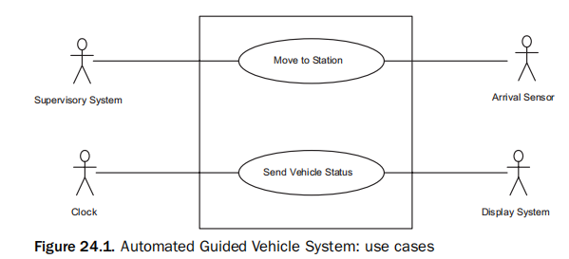
Use Case Modeling
Notes:
The use case model for the AGV System is depicted in Figure 24.1. From the problem description, it can be determined that there are two use cases, one dealing with the vehicle moving to a station and the second dealing with sending vehicle status to the display system.
There are four actors: Supervisory System, Display System, Arrival Sensor, and Clock.
From the perspective of the AGV System, the Supervisory System and Display System are external system actors.
The Arrival Sensor is an input device actor, whereas the Clock is a timer actor. The use case descriptions are given next.
The Supervisory System is a primary actor that initiates the Move to Station use case, because it sends the move command to the AGV System.
The Arrival Sensor is a secondary actor that participates in the use case as it notifies the vehicle when it has reached a station. The use case description is as follows:

Slide 5
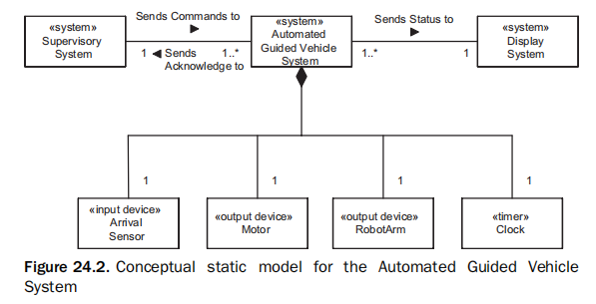
Static Modeling
Notes:
The conceptual static model is shown in Figure 24.2 using a class diagram. It depicts a system of systems, consisting of the Supervisory System, the AGV System, and the Display System.
The AGV System is modeled as a composite class, which receives commands from and sends acknowledgments to the Supervisory System, and sends status to the Display System.
The AGV System is composed of four classes: the Arrival Sensor, the Motor, the Robot Arm, and the Clock.

Slide 6
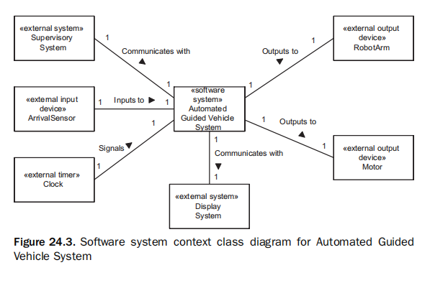
Static Modeling Software System Context Modeling
Notes:
The software system context diagram (Figure 24.3) is modeled from the perspective of the software system to be developed, the AGV System.
It therefore depicts two external system classes (the Supervisory System and the Display System) and the Clock external timer class, which were originally depicted as actors in the use case model.

Slide 7
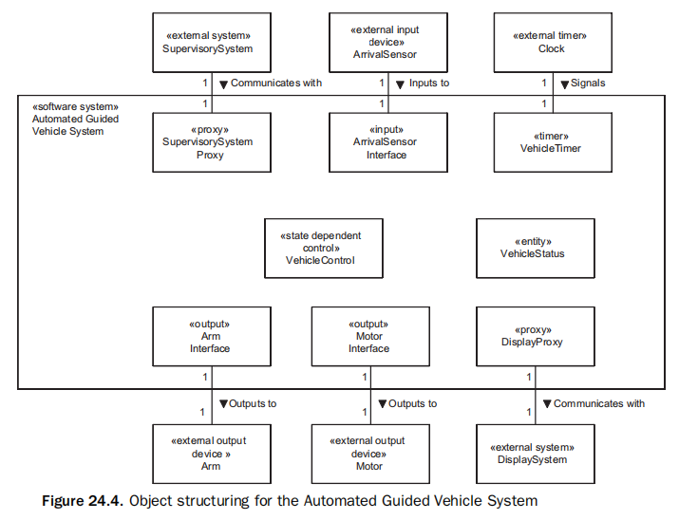
Static Modeling Object and Class Structuring
Notes:
Object structuring for the AGV System is depicted in Figure 24.4. For each external class on the software system context diagram, there is a corresponding internal software class.
Thus, there are two proxy classes, Supervisory System Proxy and Display Proxy, which communicate with the two external systems, Supervisory System and Display System, respectively.
There is one input class, Arrival Sensor Interface, which communicates with the Arrival Sensor external input device, and two output classes, Motor Interface and Arm Interface, which communicate with the Motor and Arm external output devices, respectively.
There are two additional classes, a state dependent control class, Vehicle Control, which executes the vehicle state machine, and an entity class, Vehicle Status, which contains data about the vehicle destination and command.
In addition, there is one timer class, Vehicle Timer.

Slide 8
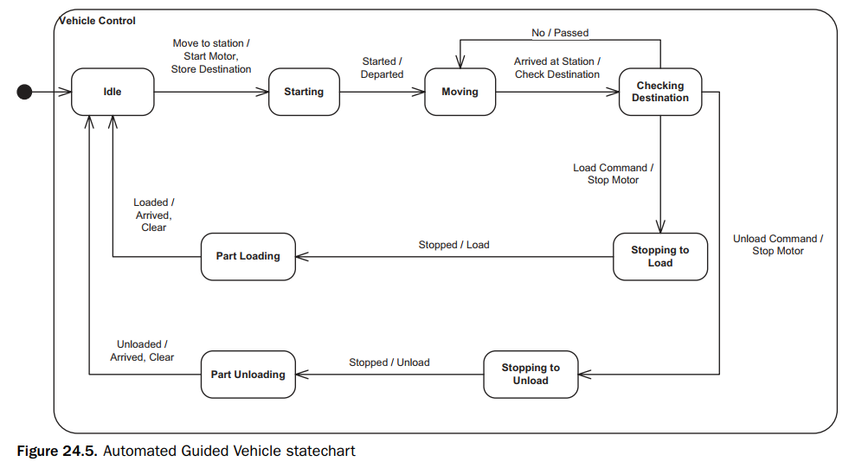
Dynamic Modeling Dynamic State Machine Modeling
Notes:
Vehicle Control executes the vehicle state machine, which is depicted on the state chart in Figure 24.5. The state machine follows the states of the vehicle as it transitions from idle state to moving, arriving at destination, loading or unloading the part, and then restarting.
The states are determined by following the main sequence textually described in the Move to Station use case, and are as follows:
Idle. This is the initial state, in which the AGV is idle, waiting for a command from the Supervisory System.
Starting. This state is entered when the AGV has received a Move to Station message from the Supervisory System and has sent a start command to the motor.
Moving. The AGV is moving to the next station.
Checking Destination. The AGV has arrived at a station and is checking to determine whether this is its destination.
Stopping to Load. This station is the destination, and the AGV is to load a part. The AGV commands the motor to stop on entry to this state.
Part Loading. This robot arm is loading the part onto the AGV.
Stopping to Unload. This station is the destination, and the AGV is to unload a part. The AGV commands the motor to stop on entry to this state.
Part Unloading. This robot arm is unloading the part off the AGV.
Note that the Stopping to Load and the Stopping to Unload states are kept separate because the actions leaving these states are different (Load and Unload, respectively).

Slide 9
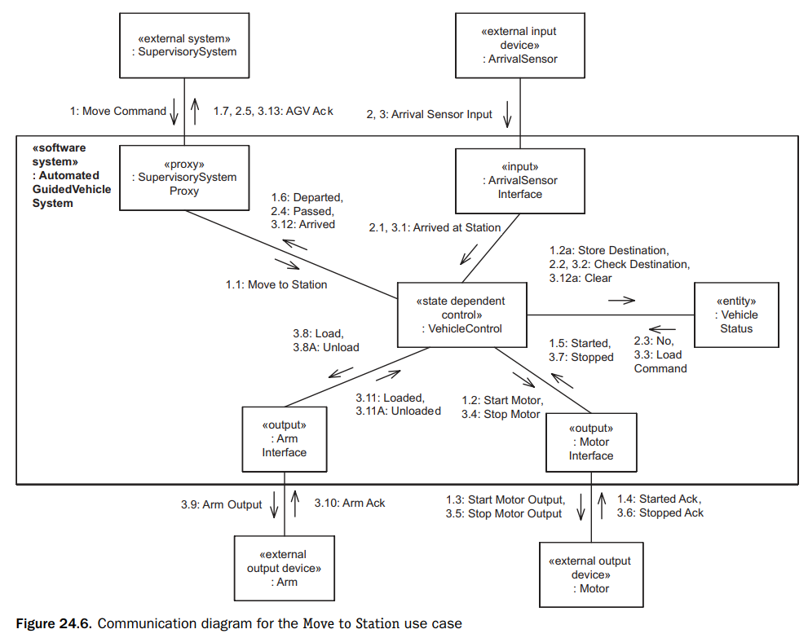
Dynamic Modeling Dynamic Interaction Modeling
Notes:
For each use case, a communication diagram is developed that depicts the objects that participate in the use case and the sequence of messages passed between them.
Several objects realize the main use case, Move to Station; however, only three software objects are needed to realize the supporting use case, Send Vehicle Status.
In the communication diagram for the Move to Station use case (Figure 24.6), the sequence of external inputs and external outputs on the communication diagram corresponds to the sequence described in the use case and starts with the command sent by the Supervisory System, which is the primary actor.
The objects that realize this use case are Supervisory System Proxy, which receives the inputs from the Supervisory System; Vehicle Control, which controls the objects that participate in the use case; Vehicle Status, for storing and retrieving destination location information;
Arm Interface and Motor Interface, for interfacing to the two external output devices; and Arrival Sensor Interface, for receiving input from the arrival sensor.
The message sequence description is as follows for a scenario in which the vehicle goes past the first station and stops at the second station to load a part

Slide 10
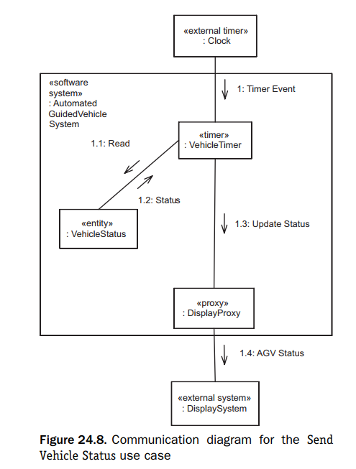
Dynamic Modeling Dynamic Interaction Modeling
Notes:
The communication diagram for the Send Vehicle Status use case is shown in Figure 24.8. The objects that realize this use case are the Vehicle Timer, which receives clock inputs, Vehicle Status, which stores status information, and Display Proxy, which sends vehicle status to the external Display System.
The message sequence starts with the external timer event from the external Clock and the message numbering is as follows:
1: Clock sends Timer Event to Vehicle Timer.
1.1, 1.2: Vehicle Timer reads Vehicle Status.
1.3: Vehicle Timer sends Update Status message to Display Proxy.
1.4: Display Proxy sends Vehicle Status to external Display System

Slide 11
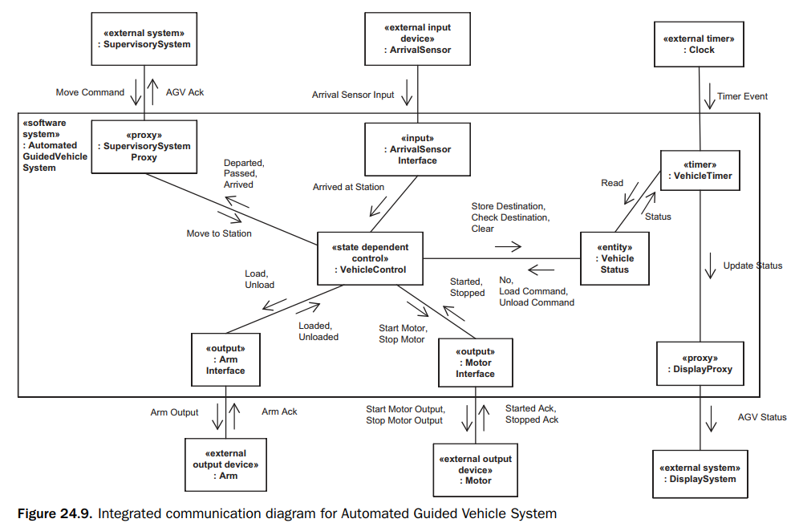
Design Modeling Integrated Communication Diagram
Notes:
The software architecture of the AGV System is designed around a centralized control pattern.
Centralized control is provided by the Vehicle Control component Real-Time Software Architecture Case Study 483 receiving inputs from the Supervisory System and the Arrival Sensor, and controlling the external environment by means of the Motor and Arm.
When viewed from the larger perspective of a factory automation system, the architecture is a based around a hierarchical control pattern, with several instances of the AGV System(each instance controlling an individual vehicle) operating under the overall direction of a Supervisory System, which provides hierarchical control of the individual AGVs by sending move commands to each vehicle.
-------------Integrated Communication Diagram
The initial attempt at design modeling involves developing the integrated communication diagram for the AGV System, which requires the integration of the two use case–based communication diagrams shown in Figures 24.6 and 24.8.
The integrated communication diagram is depicted in Figure 24.9. The integration is quite straightforward, because the only object that participates in both the use case–based communication diagrams is Vehicle Status.
The integrated communication diagram is a generic communication diagram in that it depicts all possible communications between the objects.

Slide 12
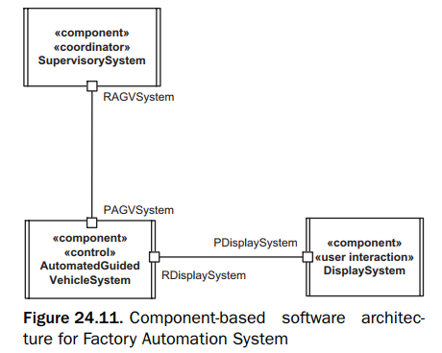
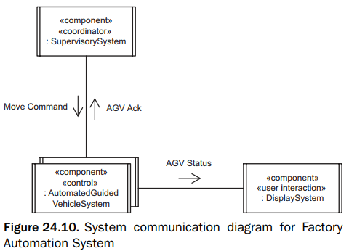
Design Modeling Factory Automation System 1/3
Notes:
The distributed software architecture for the Factory Automation System, which is a system of systems, is shown on the system communication diagram in Figure 24.10.
It depicts the three interacting distributed systems (designed as components): the Supervisory System, the Automated Guided Vehicle (AGV) System, and the Display System.
There is one instance of the Supervisory System, and multiple instances of the AGV System and the Display System. All communication between the distributed components is asynchronous, which allows the greatest flexibility in message communication.
Communication between the Supervisory System and the AGV System is an example of bidirectional asynchronous communication.

Slide 13
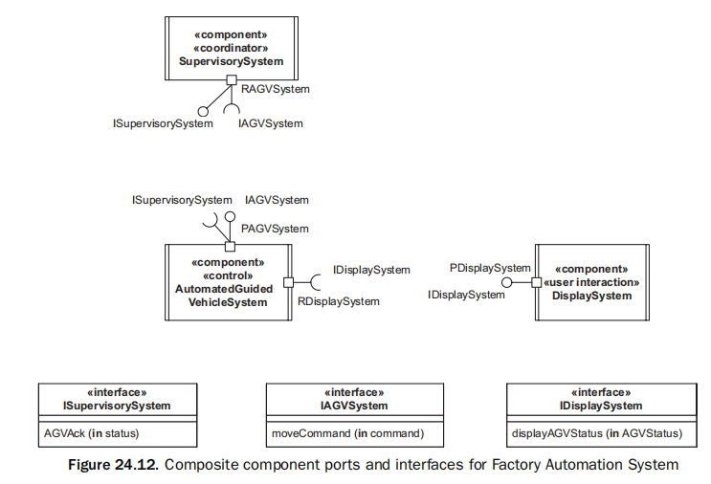
Design Modeling Factory Automation System 2/3
Notes:
The AGV System is designed as a real-time component-based software architecture.
A component-based design provides the advantages of a configurable design and follows the concepts described in Chapter 17.
The real-time design is needed because of the characteristics of the application, and it follows the concurrent task structuring criteria and message-based task interface design described in Chapter 18.
----
The design of the AGV System is based on the centralized control pattern for real-time designs (see Chapter 18).
One control component, Vehicle Control, provides the overall control of the system.
In addition, the AGV System is designed as a distributed component-based software architecture, which allows the option for input and output components to reside on separate nodes that are connected by a high-speed bus.
At system deployment time, the type of configuration required – centralized or distributed – is determined.
---
The concurrent software architecture for the AGV System is developed from the integrated communication diagram by applying the task structuring criteria to design the concurrent tasks and architectural communication patterns to design the message communication between tasks.
Next the component-based architecture is designed.
Finally, the provided and required interfaces of each component are described.
Each component port is defined in terms of its provided and/or required interfaces.

Slide 14
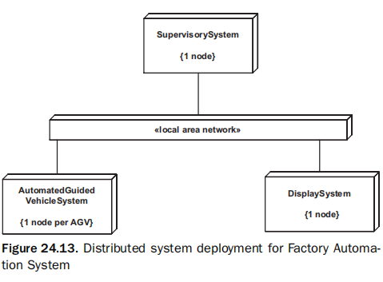
Design Modeling Factory Automation System 3/3

Slide 15
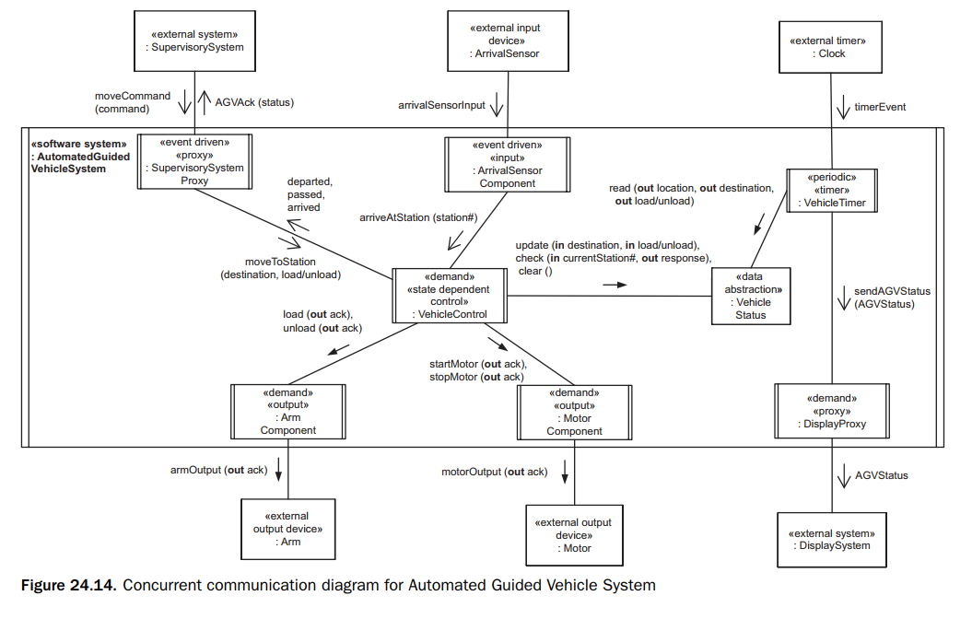
Design Modeling Concurrent Software Architecture
Notes:
In this concurrent real-time design, the concurrent task structuring criteria are applied to determine the tasks in the Automatic Guided Vehicle System.
The concurrent task design (see Figure 22.14) is developed by starting from the integrated communication diagram in Figure 24.9, which depicts all the objects in the AGV System.
All these objects are concurrent because they need to operate independently, except Vehicle Status, which is a passive data abstraction object.
Because the goal is to design a concurrent component-based software architecture, the tasks are all designed as simple concurrent components, each with its own single thread of control.
Thus, in this design, the terms task and simple component are synonymous. The concurrent tasks are described in the following list.
----
Input tasks. Concurrent input tasks receive inputs from the external environment and send corresponding messages to the control task. Arrival Sensor Component (Figure 24.14) is designed as an event-driven input task, which is awakened by the arrival of an arrival sensor input.
The input task consists of the individual input device interface object depicted in the analysis model (see Figure 24.9): Arrival Sensor Interface.
---
Proxy tasks. Supervisory System Proxy acts on behalf of the Supervisory System, from which it receives Move commands that are forwarded to Vehicle Control, and it sends AGV acknowledgements to Supervisory System.
Supervisory System Proxy is designed as an event-driven task, which is awakened by messages from either the external Supervisory System or the internal Vehicle Control.
Note that if a task receives both external and internal messages, it is categorized as an event driven task and not a demand driven task. Display Proxy acts on behalf of the Display System, to which it forwards AGV status messages.
Display Proxy is designed as a demand driven task, awakened on demand by the arrival of a message from Vehicle Timer.
----
Control task. Vehicle Control is the centralized state dependent control task for the AGV system.
It executes the Vehicle Control state machine and receives messages from other tasks that contain events, causing Vehicle Control to change state and send action messages to other tasks.
Vehicle Control is designed as a demand driven task, which is awakened by arrival of a message from either Supervisory System Proxy or Arrival Sensor Component.
----
Output tasks. The Arm Component interfaces to the external Arm. The Arm Interface object from the analysis model is mapped to this output task (see Figures 24.9 and 24.14).
Similarly, the Motor Component interfaces to the external Motor and is designed from the analysis model Motor Interface object.
Both of the output tasks are designed as demand driven tasks, which are awakened on demand by arrival of a message from Vehicle Control.

Slide 16
Design Modeling Architectural Communication Patterns
To handle the variety of communication between the tasks in the AGV System, four communication patterns are applied
Asynchronous Message Communication
Bidirectional Asynchronous Communication
Synchronous Message Communication without Reply
Call/Return

Slide 17
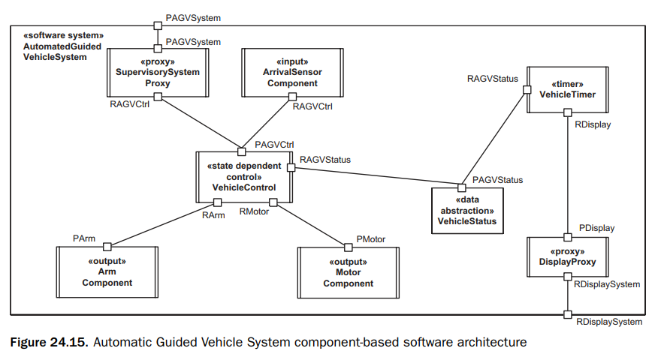
Design Modeling Component-Based Software Architecture
The Automated Guided Vehicle System component is designed as a composite component that contains eight simple part components; seven of these are concurrent components (Supervisory System Proxy, Arrival Sensor Component, Vehicle Control, Vehicle Timer, Arm Component, Motor Component, and Display Proxy), and the other is a passive data abstraction object (Vehicle Status).

Slide 18
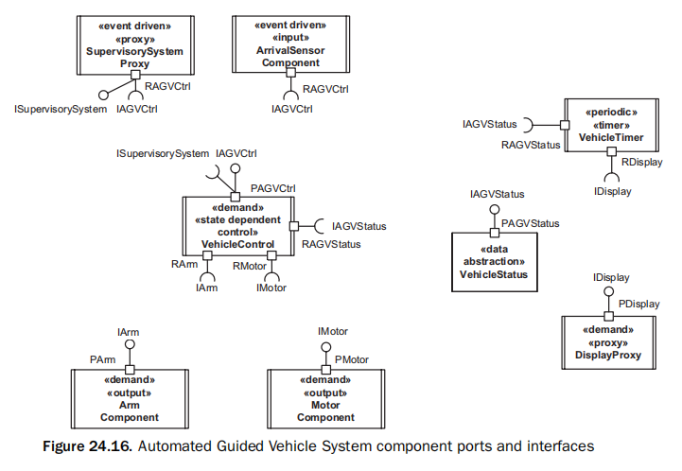
Design Modeling Design of Component Interfaces 1/3
Notes:
Each component port is defined in terms of its provided and/or required interfaces.
Some producer components – in particular, the input component – do not provide a software interface, because they receive their inputs directly from the external hardware input device.
However, they require an interface provided by the control component in order to send messages to the control component.
Figure 24.16 depicts the port and required interface for the input component Arrival Sensor Component.
This input component, as well as the Supervisory System Proxy component, has the same required interface – IAGVControl, which is provided by the Vehicle Control component.
---------
The output components do not require a software interface because their outputs go directly to external hardware output devices.
However, they need to provide an interface to receive messages sent by the control component.
Figure 24.16 depicts the ports and provided interfaces for the two output components of the AGV System.

Slide 19
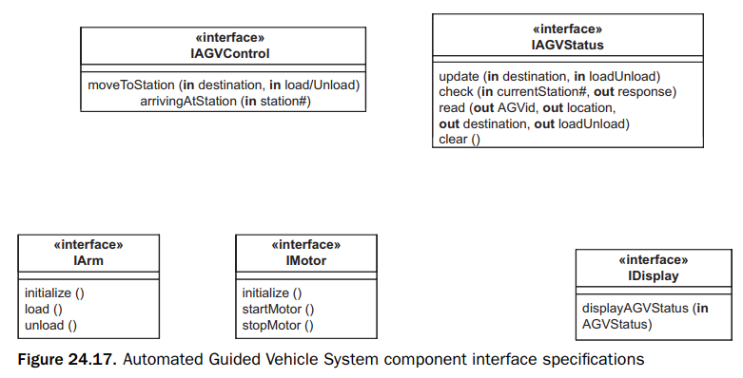
Design Modeling Design of Component Interfaces 2/3
Notes:
Figure 24.17 also shows the specifications of the interfaces in terms of the operations they provide. The Arm Component and Motor Component output components each have a provided port:
PArm for Arm Component, which provides the interface IArm
PMotor for Motor Component, which provides the interface IMotor
The Display Proxy component has a provided port called PDisplay, which in turn provides an interface called IDisplay, as shown in Figure 24.16. Figure 24.17 shows the specification of the interface.
---
Some components, such as control components, need to provide interfaces for the producer components to use and require interfaces that are provided by output components.
The Vehicle Control component has several ports – one provided port and three required ports – as shown in Figure 24.16.
Each required port is used to interface to a different consumer component and is given the prefix R – for example, RArm.
The provided port, which is called PAGVControl, provides the interface IAGVControl, which is required by the producer components.
----
Figure 24.17. It is kept simple by having only one operation, processControlRequest, which has an input parameter, controlRequest, that holds the name and contents of the individual message.
Having each control request as a separate operation would make the interface more complicated when considering evolution of the system because it would need the addition or deletion of operations rather than changing a parameter.
---
The ports and interfaces of the periodic timer component are shown in Figures 24.16 and 24.17. The Vehicle Timer has two required ports with two required interfaces.
The first required interface is IAGVStatus, which allows it to read AGV status information from the Vehicle Status data abstraction object.
The second required interface is IDisplay, which allows Vehicle Timer to send AGV status messages to Display Proxy

Slide 20
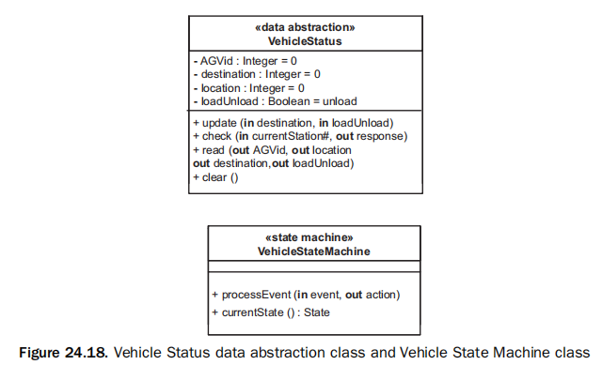
Design Modeling Design of Component Interfaces 3/3
Notes:
The update operation stores the next AGV destination and the command to be executed there (load or unload).
The check operation receives the current station number and returns whether this is the destination or not; if it is the destination, it also returns whether the station command is load or unload.
The read operation returns the location, destination, and load/unload command.
The attributes of the Vehicle Status data abstraction class are given in Figure 24.18.
This figure also depicts the state machine class design for Vehicle State Machine, which is encapsulated inside the Vehicle Control component.

Slide 21


